Slide 1
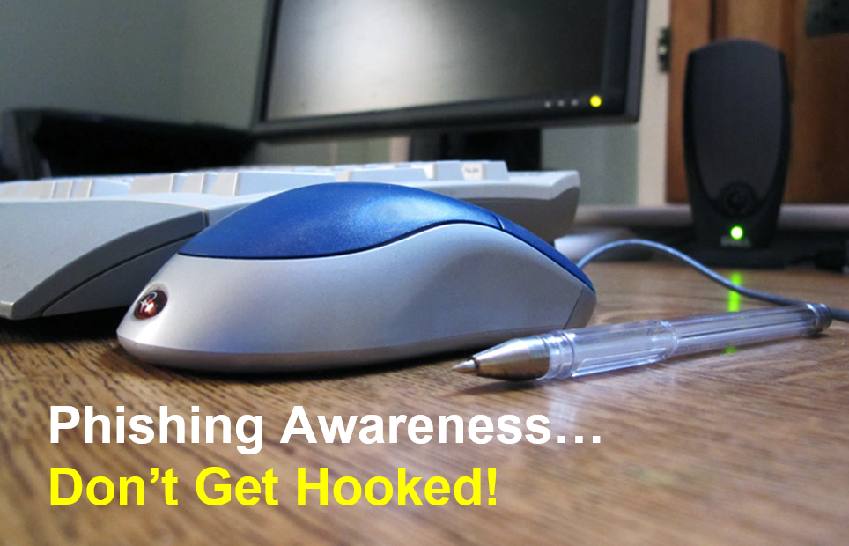
Notes:
As technology evolves over time so has the criminal. Two hundred years ago it was stage coach robberies. Then the criminals moved to bank robberies and other stores with perceived large quantities of cash on hand. Today, the criminal has turned to cybercrime. One of the most lucrative techniques utilized by cyber criminals today is social engineering and phishing.

Slide 2
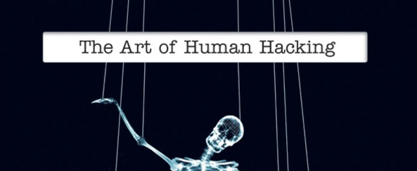

What is Social Engineering?
An act of using deceptive techniques to gain the trust of someone in order to get them to expose information they normally would not disclose.
Social Engineering methods may include:
phone call: where they masquerade as someone who they are not
e-mail: that has malicious program attached or link to a web page. The attached file or web page would contain a virus, and executing it would lead to infection.
Notes:
Social Engineering
Someone engaged in Social Engineering will use deceptive techniques and attempt to gain the trust of someone in order to get them to expose information that they normally would not disclose. This could be a phone call to a help desk, where they masquerade as someone who they are not, or it could be an e-mail that has malicious program attached. Many viruses use social engineering techniques to trick people into getting infected. A common technique is to create a fraudulent return address based on the recipient's e-mail address, indicating that it is from their IT support group, urging one to execute an attached file to restore access to your network account. Of course, the attached file would contain a virus, and executing it would lead to infection.
In the case of a phishing attack, the social engineer is trying to gain access to more than just a computer account or control of a computer system. In this case, the goal is to attain financial information in order to defraud people. As more banks move to provide on-line service, the stereotypical teen-age hacker has been replaced by organized crime, and in some cases, according to Cutter, terrorist organizations.
HOW TO PROTECT YOURSELF AND IDENTIFY SOCIAL ENGINEERING ATTEMPTS?
Be suspicious of unsolicited phone calls requesting information about you or your family members
Remember that Social Engineering attempts can happen via (Email, Telephone Calls, Web Pages, Snail Mail, Face to Face, and many other ways)
Don’t believe everything you read. Just because an email or website is presented in a professional manner does not mean that it’s telling you the truth.
NEVER supply personal information about yourself or others unless you are certain of a person’s identify and their authority to request such information
NEVER click on links in Email Messages from sources you do not know
Use EXTREME CAUTION when presented with emails regarding (TAXES, Bank Accounts, User Accounts)

Slide 3
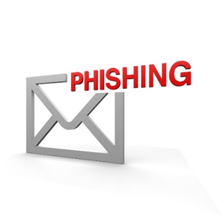
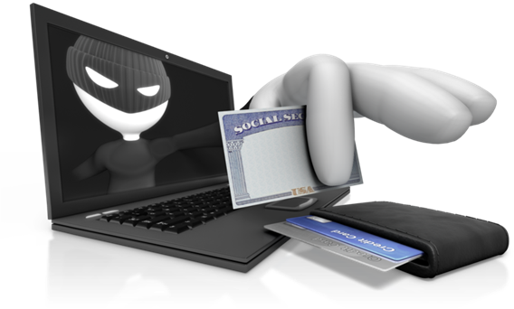
In a phishing attack…..
….the social engineer is trying to gain access to more than just an account or control of a computer system.
The goal usually is to attain personal information in order to defraud people.

Slide 4

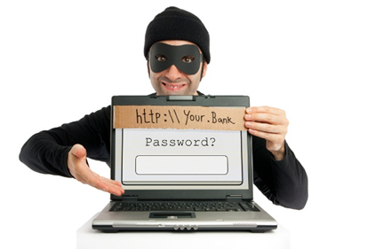
What is Phishing?
"Phishing" is an attempt by an individual or group to solicit personal information from unsuspecting users by employing social engineering techniques.
Phishing emails are crafted to appear as if they have been sent from a legitimate organization or known individual.
Notes:
What is Phishing?
Phishing is an attempt by an individual or group to solicit personal information from unsuspecting users by employing social engineering techniques. Phishing emails are crafted to appear as if they have been sent from a legitimate organization or known individual. These emails often attempt to entice users to click on a link that will take the user to a fraudulent website that appears legitimate. The user then may be asked to provide personal information such as account usernames and passwords that can further expose them to future compromises. Additionally, these fraudulent websites may contain malicious code.
Phishing attacks use 'spoofed' e-mails and fraudulent websites designed to fool recipients into divulging personal financial data such as credit card numbers, account usernames and passwords, social security numbers, etc. By hijacking the trusted brands of well-known banks, online retailers and credit card companies, phishers are able to convince recipients to respond to them.
Phishing is the term given to the practice of convincing people to disclose their personal or banking information through the use of fraudulent websites and e-mails. The term evolved in the mid-1990s by "Social Engineers" who would "fish" for account information from users on America On-Line.

Slide 5
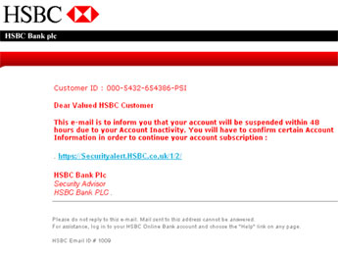
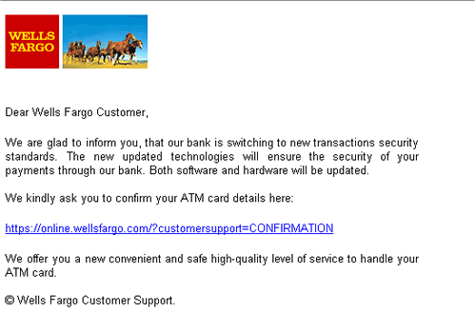
How to recognize a phishing email?
Most financial institutions/online services will not send a request for sensitive personal information to be sent over the Internet. Such a request should be viewed with cautious skepticism.
Many scam e-mails utilize some common techniques in order to harvest information from people:
"Your account has been (or will be) suspended." - sense of urgency for you to react
"Dear Valued Customer…" - A non-personalized e-mail that inform your account status is in danger.
Notes:
Most financial institutions or online services will not send a request for sensitive personal information be sent to them over the Internet. Such a request should be viewed with cautious skepticism. Many scam e-mails utilize some common techniques in order to harvest information from people:
"Your account has been (or will be) suspended." Provides a sense of urgency for you to react quickly to avoid problems with your account, such that you might act in a more hasty manner.
"Dear Valued Customer . . . " A non-personalized e-mail indicating that your account status is in danger is almost always a warning sign that an e-mail is not legitimate.
"Click on the following link . . ." Be wary of links in an e-mail. It is easy to be deceptive in using HTML.
"Click on the attachment . . . " Don't click on the attachment. It's probably a virus, a trojan, or a key logger. A legitimate request will not have an attachment for you to execute. Don't open any attachment that you were not expecting - even if there is a very compelling case to do so. Many viruses use this technique to spread.
"Poor grammar or spelling" Initial phishing e-mails were easy to spot, as the were full of spelling and grammatical errors. Nowadays, many look as good or better than actual e-mails from an on-line bank.

Slide 6

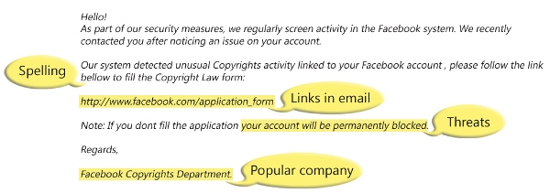
How to recognize a phishing email?
"Click on the following link . . ." Be wary of links in an HTML e-mail. It might be a fake link
"Click on the attachment . . . " Don't click or open any attachment that you were not expecting - even if there is a very compelling case to do so. Many viruses use this technique to spread.
"Poor grammar or spelling" Initial phishing e-mails were easy to spot, as they were full of spelling and grammatical errors. Nowadays, many look as good or better than actual e-mails from an on-line bank or services.
Pay attention to the URL of a website. Malicious websites may look identical to a legitimate site, but the URL may use a variation in spelling or a different domain (e.g., .com vs. .net).
Notes:
Image: http://www.microsoft.com/security/online-privacy/phishing-symptoms.aspx

Slide 7
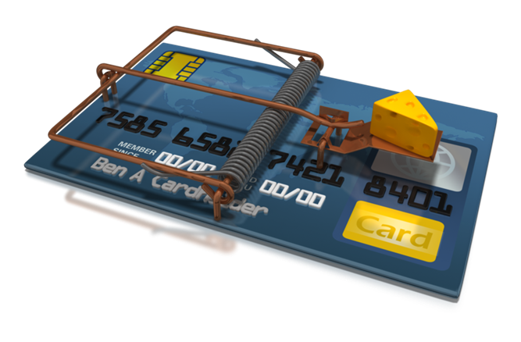
Don’t take the bait!
Many viruses pretend to be legitimate programs and security tools. Clicking on links or attachments in unexpected e-mails is a common method of infection.
Since the exposure of passwords from social networking services, scammers have been improving their techniques for trying to craft more and more believable e-mails. These are all intended to infect your computer with malicious programs designed to commit identity theft or steal intellectual property.

Slide 8
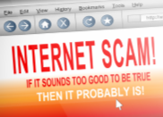
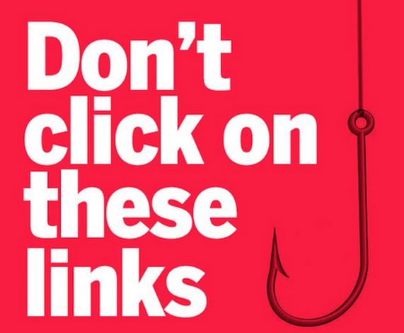
What to do if you receive a Phishing e-mail?
DO NOT CLICK on any links (or attachment(s)) in the e-mail – no matter how urgent the instructions may be.
These links are designed to take you to a site where malware will attempt to install itself on your machine.
If it is a notification from a legitimate business – you should be able to contact the business via telephone or e-mail to confirm that the notification is legitimate.
If it is from your banking institution, go directly to their website for up to date information.
Notes:
Additionally, the U.S. Computer Emergency Readiness Team is accepting phishing e-mails for follow up. If you have a phishing e-mail that you would like to submit, follow the directions on their website. https://www.us-cert.gov/report-phishing

Slide 9
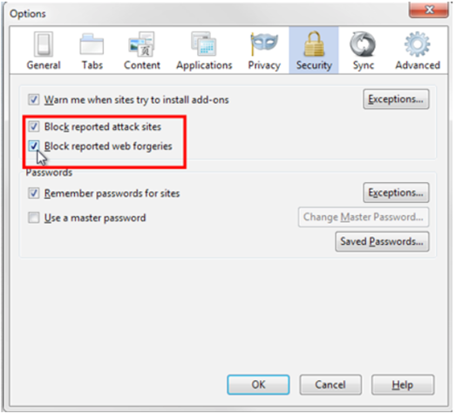
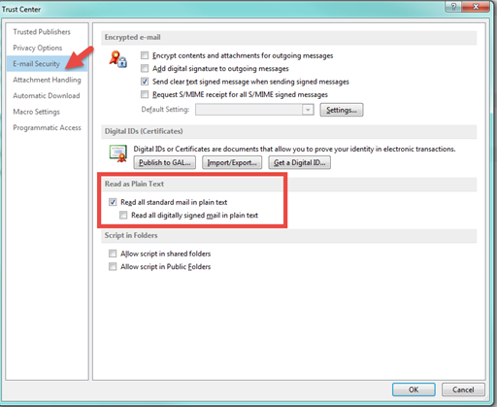
What can you do to reduce your risks?
Enable anti-phishing features in browsers:
Firefox – Phishing protection
https://support.mozilla.org/en-US/kb/how-does-phishing-and-malware-protection-work
Internet Explorer – SmartScreen
http://windows.microsoft.com/en-US/windows7/SmartScreen-Filter-frequently-asked-questions-IE9#
Prevent security risk in mail clients, ie.:
Disable HTML email: Outlook > Trust Center > Trust Center Settings > E-Mail > Read email as plain text

Slide 10
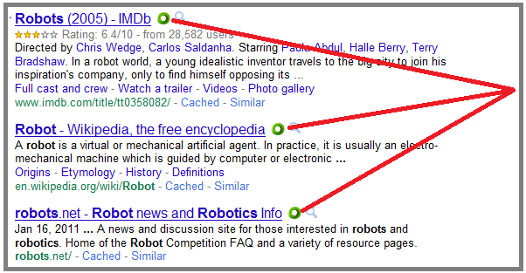
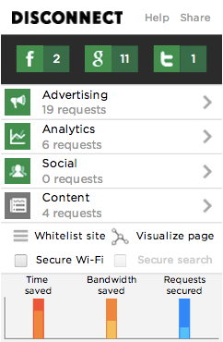

Other Tools you can use
Safe Browsing Tool Web of Trust (www.mywot.com)
Allows you to see if a link is a known safe website or not
Protect your online Privacy Disconnect.me (https://disconnect.me/)
Allows you to control your personal information that is analyzed by websites.
Notes:
Web of Trust allows you to see the potential security in links embedded in emails as well as websites and search engines.
The plug-in uses a traffic light approach to give you their security rating of the link.
Green is safe; Yellow – proceed with caution; Red – Unsafe do not follow the link; Grey – No information available be careful.

Slide 11
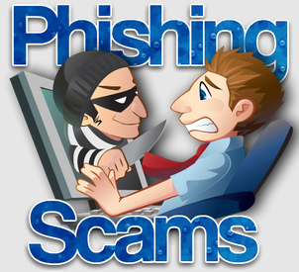
What to do if you think you’ve fallen victim?
If you believe you might have revealed sensitive information about your organization, report it to the appropriate people within the organization, including network administrators. They can be alert for any suspicious or unusual activity.
If you believe your financial accounts may be compromised, contact your financial institution immediately and close any accounts that may have been compromised. Watch for any unexplainable charges to your account.
Immediately change any passwords you might have revealed. If you used the same password for multiple resources, make sure to change it for each account, and do not use that password in the future.
Watch for other signs of identity theft.
Consider reporting the attack to your local authorities.

Slide 12
Additional information
How to Avoid Phishing Scams
http://www.antiphishing.org/resources/overview/avoid-phishing-scams
FBI's Common Fraud Schemes information page
http://www.fbi.gov/scams-safety/fraud
STOP. THINK. CONNECT. - a consumer awareness program
http://stopthinkconnect.org/
Bank Safe Online from our research partners APACS in the UK
http://www.banksafeonline.org.uk/
Federal Trade Commission "Avoid ID Theft: Deter, Detect, Defend", a campaign to advise consumers on techniques to neutralize identity theft
Site Jabber Blog, a consumer protection service which helps people avoid fraudulent websites and find ones they will love.
Good collection of articles on "Identity Theft & Data Breaches" hosted by the Privacy Rights Clearinghouse.
Wombat Security Technologies have developed this cute little game to help customers recognize phishing attacks. Play the first round of AntiPhishing Phil and see how knowledgeable you are.
Notes:
How to Avoid Phishing Scams http://www.antiphishing.org/resources/overview/avoid-phishing-scams
FBI's Common Fraud Schemes information page http://www.fbi.gov/scams-safety/fraud
STOP. THINK. CONNECT. - a consumer awareness program http://stopthinkconnect.org/
Bank Safe Online from our research partners APACS in the UK http://www.banksafeonline.org.uk/
Federal Trade Commission "Avoid ID Theft: Deter, Detect, Defend", http://www.consumer.gov/section/scams-and-identity-theft
Site Jabber: http://www.sitejabber.com/blog/
Identity theft and Data Breaches: http://www.privacyrights.org/identity-theft-data-breaches
Wombat Technologies: http://www.wombatsecurity.com/

